Slide 1
Ecommerce Website
November
2022

Slide 2
Content presentation
Project Info
Pages
Functionalities
Bugs
Improvements

Slide 3






Project Info
Ecommerce website with products designed for outdoor activities.
Tools used:
Visual Studio Code
HTML, CSS, JavaScript, Bootstrap
JSON Database / MockAPI
Postman
AJAX methds

Slide 4
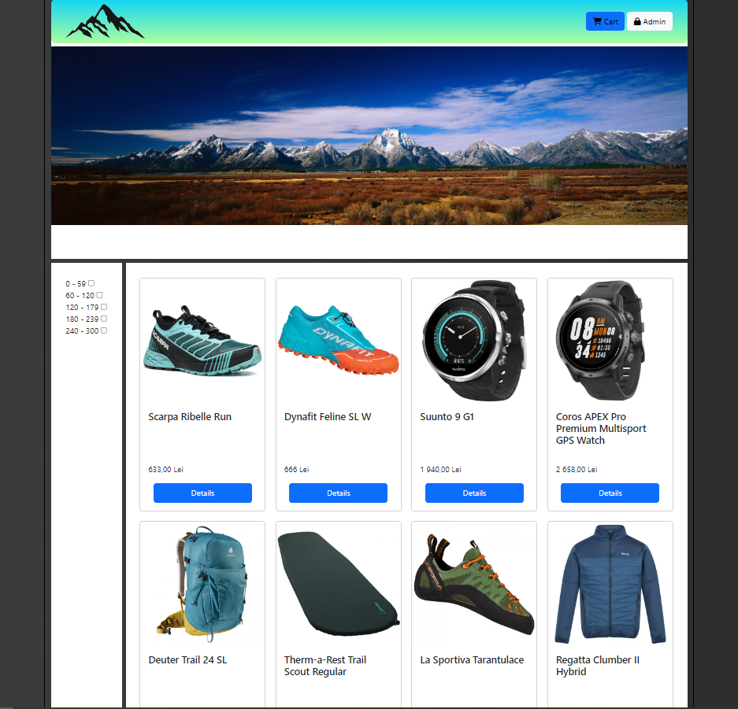

Pages
Home Page
The Home Page displays an intuitive navigation Navbar, with a icon on the left which is also the back link to home page from anywhere inside the website.
On the right side we have the Cart and the Admin page.
Further down, we have the page banner and the products.

Slide 5
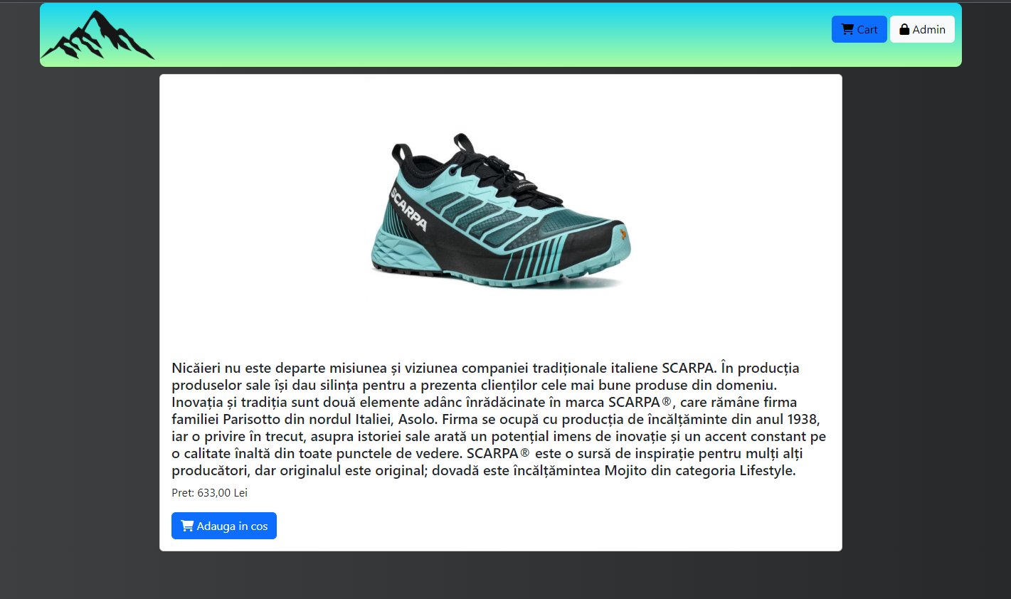
Pages
Details Page
Starting from the top, we have the navigation bar with the Site Logo and two buttons (Cart and Admin).
By clicking the logo, the user is redirected to home Page.
Next is the product details where the users ca see product specification, price and a button to ad the desired product to cart.

Slide 6
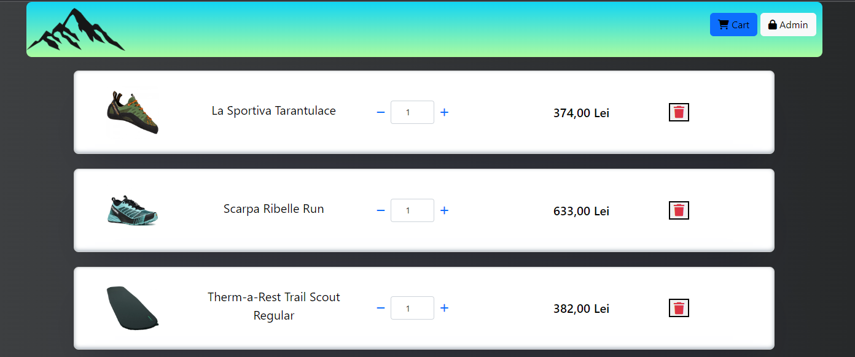
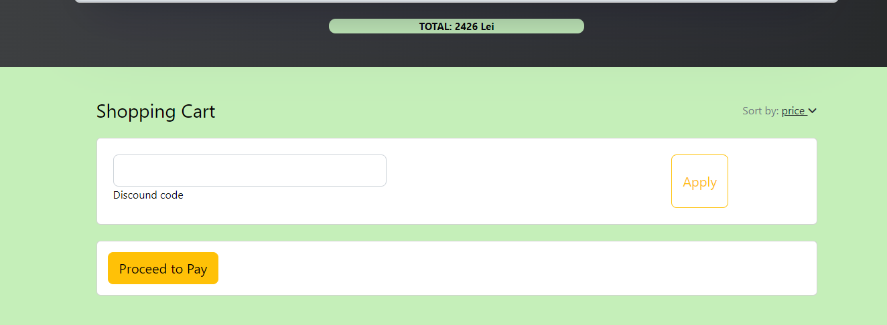
Pages
Cart Page
Cart page belongs to the users/buyers. Here, they have an overview of the desired products, and are able to perform multiple actions:
Increase or decrease desired quantity for the products;
Delete products from cart;
See total amount of selected products;
Delete products;
Discont code also available on site.

Slide 7
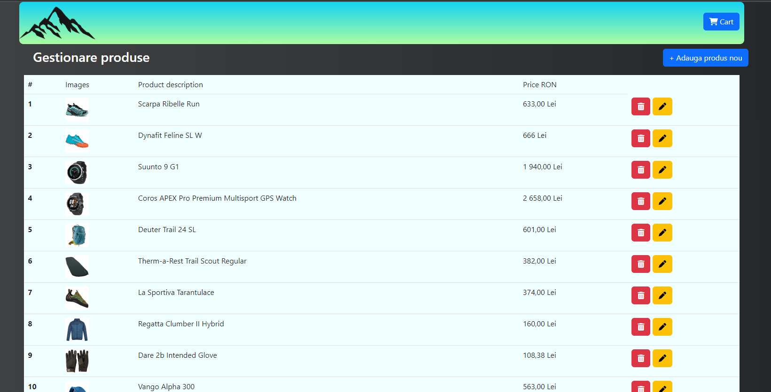
Pages
Admin Page
Welcome to the place where the website magis takes place. The administrator of the webpage is able have an overview of the entire product list and perform multiple actions, such as:
Adding new products;
Deleting existing products
Editing products

Slide 8
Bugs & improvements
Responsiveness
JS features
Button responsiveness
JS needs to be better understood and put in practice for a better user experience.
Discount button not operable;
When editing product list, user must press twice the button for the form to appear.
The webpage is not entirely responsive for phones and tablets.

Slide 9
THANK YOU!
Razvan Grigorescu
Web address:
Final Project - OutdorShop Online Store (surge.sh)
Email
grigorescurazvan@yahoo.com

